Slide 1
Sensor Data Fusion
NC 812/ESD 812

Slide 2
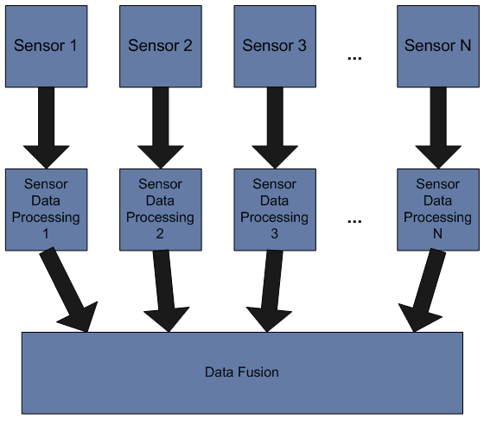
Data Fusion

Slide 3
Data Fusion
Data fusion is the process of integration of multiple data and knowledge representing the same real-world object into a consistent, accurate, and useful representation.
Fusion of the data from 2 sources (dimension #1 & #2) can yield a classifier superior to any classifiers based on dimension #1 or dimension #2 alone. E.g. accelerometer and gyro in the mobile used together to determine the orientation.
Data fusion processes are often categorized as low, intermediate or high, depending on the processing stage at which fusion takes place. Low level data fusion combines several sources of raw data to produce new raw data. The expectation is that fused data is more informative and synthetic than the original inputs.

Slide 4
Decision Fusion
In decision fusion individual decisions from various sensors are fused into a unified one without sending raw data to the fusion centre. It provides a flexible solution for improving the classification accuracy without considering the classifiers used in local sensors.
In decentralized target classification systems with decision fusion, each sensor independently conducts classification operation and uploads its local decision to the fusion centre, which combines these decisions into a global one.

Slide 5
Definition
Data fusion is a multilevel, multifaceted process dealing with the
  registration,
  association,
  correlation, and
  combination of data and information
from multiple sources to achieve refined state and identity estimation, and complete and timely assessments of situation (including threats and opportunities).
Sensors produce individual observations or measurements (raw data) that must be placed in proper context first to create organized data sets (information) and then evaluated to infer higher-level meaning about the overall content in the information (knowledge).

Slide 6
Data Fusion
Registration: Registration (or alignment) is the process that places all sensor data in a common time and space coordinate system. This corrects for the different time sampling, viewing perspective and image planes of different sensors.

Slide 7
Data Fusion
Correlation and Association: The process of fusion which partitions data into associated categories includes correlation and association stages. Sensor measurements are compared with correlation metrics that use temporal, spectral or spatial properties to score each alternative assignment hypothesis. The sensor data are then associated with the corresponding data from other sensors and are assigned to categories.
Combination: The process of combining data from all sensors to derive a refined estimate of state and identity must manage the uncertainty in sensor measurements and provide estimates with associated measures of estimate uncertainty

Slide 8
Data vs. Decision
The difference between data and decision is obvious. The raw data is used to make a decision. Decision may be binary, ternary and so on.
Decision can also be hard or soft decision.
For example, consider a fire detection system, based on the data received, the decision to be could be:
  There is fire, sound the alarm (1)
  There is no fire, don’t sound the alarm (0)
Or there may be a third alternative
  Unclear response, please check the system (x)

Slide 9
Hard Decision
The decisions discussed above hard decisions. These decisions don’t give us an insight into the data used to make the decisions and/or how reliable the data was!
Let’s say the data used to make a decision about fire was data from temperature sensor. The simple decision logic being:
if(temp > threshold)
  fire=true
else
  fire = false
end
The threshold is some temperature set by the user. A binary hard decision is made in this case based on the temperature.

Slide 10
Hard Decision
The binary decision is easy to process but doesn’t give any information about how confident we are about the decision made. E.g. if we are using water sprinklers along with the alarm, we would like to be really sure that there is a fire before sprinklers are started.
Let’s say the threshold is 80C and the recorded temperature is 81 C in case 1 and 100 C in case 2.
It is obvious that we would have far more confidence in our decision in case 2 than in case 1. A hard decision takes away this underlying information. Instead of a binary hard decision, soft decision could be made such that:
000 | 001 | 010 | 011 | 100 | 101 | 110 | 111
No fire |  |  |  |  |  |  | Fire

Slide 11
Soft Decision
Based on the soft decision provided, different actions can be taken. While soft decision making requires more processing, it can make for better decisions and more reliable systems.

Slide 12
Decision Logic
Let the output of the temperature sensor be modelled as:
x=s+b+n
Where
s represents the accurate value
b represents the bias
n represents measurement noise, modelled as N(0, σ²)
x is the actual reading
The bias can be estimated and eliminated from the data relatively easily, resulting in a simpler model,
x=s+n

Slide 13
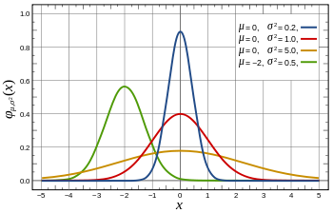
Decision Logic

Slide 14
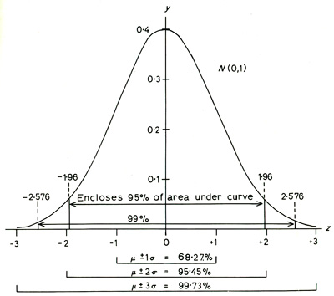
Reliability of Decision
High reliability (precision): low measurement noise (low σ²)
Low reliability (precision): high measurement noise(high σ²)

Slide 15
Confidence Interval
If the actual temperature is 30C and measurement noise variance is 4, the probability that the reading will be between 28-32 C is 0.68.
In other words, if the reading observed is 30C, we are 95.45% sure that the actual temperature is between 26C and 34 C. The 95.45% confidence interval is [26 34].
Thus, any decision taken should take into account this uncertainty. A control algorithm must take this uncertainty into account.

Slide 16
Reliability
The data is modelled as a stochastic process following a normal distribution. The decision made based on the data will have an uncertainty associated with it.
This uncertainty has been well captured in Detection Theory by two terms, Probability of false alarm and Probability of missed detection.

Slide 17
Detection Theory
We assume a parametric measurement model p(x | θ). In point estimation theory, we estimated the parameter θ ∈ Θ given the data x.
Suppose now that we choose Θ₀ and Θ₁ that form a partition of the parameter space Θ: Θ₀ ∪ Θ₁ = Θ, Θ₀ ∩ Θ₁ = ∅.
In detection theory, we wish to identify which hypothesis is true (i.e. make the appropriate decision):
H₀ : θ ∈ Θ₀, null hypothesis
H₁ : θ ∈ Θ₁, alternative hypothesis.

Slide 18
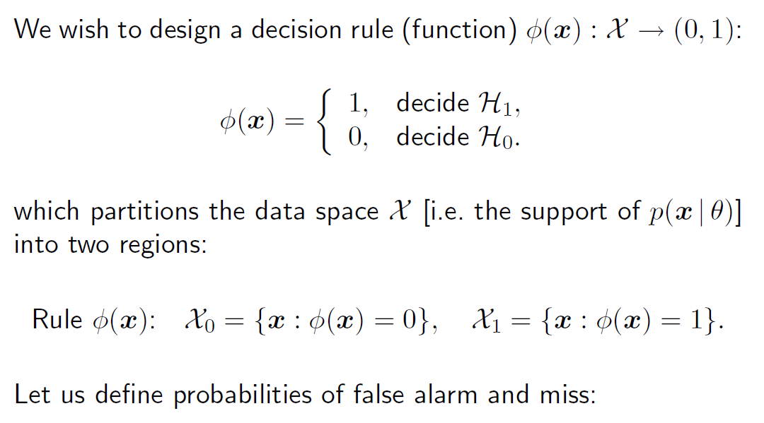
Decision Rule

Slide 19
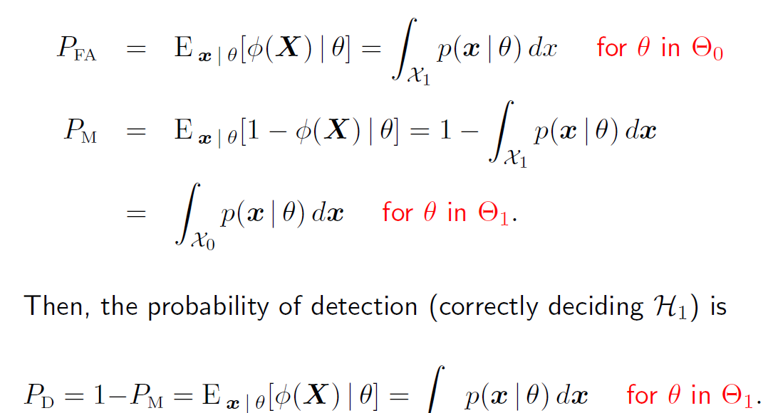
Probabilities

Slide 20
Example
If the fire alarm is sounded, we would like to be 95% sure that there is actually a fire. If there is a sprinkler system, we may need 99% accuracy.
If the actual temperature is the room in 80C, we are sure that there is fire in the room. The sensor reading is known to be noisy and sensor noise is modeled N[0,1]. Any bias present has been adjusted during calibration.
Control algorithm is simple, given next.

Slide 21
Example
if(temp > threshold1)
  fire_alarm=true
else
  fire_alarm = false
end
if(temp > threshold2)
  sprinkler=true
else
  sprinkler = false
end

Slide 22
Improving the Reliability
If we want a smaller confidence interval, we must reduce the measurement noise variance. One of the well known ways of achieving that is time domain averaging.
For example, if the temperature readings were averaged over 100 samples, the variance would be reduced by a factor of 10.
There is a limit to how much averaging you can do. Larger the averaging window, higher is the latency of the system. If a temperature reading is taken every 1 minute and averaged over 100 samples, any decision will be taken after 100 minutes, which may be too late.

Slide 23
Spatial Data Fusion
The temperature data from different sensors in a room could be averaged to get a better, more precise value. Reduction in variance will be equal to square root (N) where N is the number of sensor readings.
It should be noted that these readings will be correlated with each other.

Slide 24
Fire Alarm System
Consider a fire alarm system utilizing 3 types of sensors:
1. Smoke sensor
2. Temperature sensor
3. Heat sensor
Each sensor will provide a binary decision, i.e. fire or not. The threshold for the decisions are programmed internally over which we may or may not have control.

Slide 25
Fire Alarm System
The accuracy of each sensor (based on the programmed thresholds) are as listed below. The event to be detected is presence of fire or not (F=1 or 0)
  Smoke sensor: P_{d} = 0.9, P_{f} = 0.05
  Temp Sensor: P_{d} = 0.95, P_{f} = 0.1
  Heat Sensor: P_{d} = 0.8, P_{f} = 0.01

Slide 26
Decision Fusion
AND Logic:
(Alarm = 1) iff (smoke =1)&(Temp=1)&(Heat=1)
Will result in lower P_{f} and low P_{d}. Can you compute the P_{d}/P_{f} for the information given?

Slide 27
P_{d} and P_{f}
P_{d} = P(A=1|Fire=1)
P_{d} = P(S=1|F=1)P(T=1|F=1)P(H=1|F=1)
P_{d} = 0.9*0.95*.8=0.6840
P_{f} = 0.05*0.1*0.01 = 0.00005

Slide 28
OR Logic
(Alarm = 1) iff (smoke =1)|(Temp=1)&|(Heat=1)
Will result in high P_{f} and high P_{d}. Can you compute the P_{d}/P_{f} for the information given?

Slide 29
OR Logic
P_{d} = P(A=1|F=1)
P(A=1|F=1) = P(S=1|F=1) + P(T=1|F=1) + P(H=1|F=1)
P_{d} = 0.9+0.95+0.8 =2.65 (Probability greater than 1?????)
What is the mistake??

Slide 30
OR Logic
P_{d} = P(A=1|F=1)
P(A=1|F=1) = P(S=1|F=1) + P(T=1|F=1) + P(H=1|F=1)
P_{d} = 0.9+0.95+0.8 =2.65 (Probability greater than 1?????)
What is the mistake??
Remove the redundancy:
P_{d} = P_{d1} + P_{d2} + P_{d3} - P_{d1}*P_{d2} – P_{d2}*P_{d3} – P_{d1}*P_{d3} + P_{d1}*P_{d2}*P_{d3}
Or
P_{d} = 1 – P_{m1}*P_{m2}*P_{m3}

Slide 31
Majority Logic

Slide 32
Possible Outcomes
Following results are possible with probabilities as stated next:
Ground Truth: F=1
Smoke Detector Output | Temp sensor output | Heat Sensor Output | Decisions AND OR ML
1 (P_{d1}) | 1 (P_{d2}) | 1 (P_{d3}) | 1 | 1 | 1
1 (P_{d1}) | 1 (P_{d2}) | 0 (P_{m3}) | 0 | 1 | 1
1 (P_{d1}) | 0 (P_{m2}) | 1 (P_{d3}) | 0 | 1 | 1
0 (P_{m1}) | 1 (P_{d2}) | 1 (P_{d3}) | 0 | 1 | 1
1 (P_{d1}) | 0 (P_{m2}) | 0 (P_{m3}) | 0 | 1 | 0
0 (P_{m1}) | 1 (P_{d2}) | 0 (P_{m3}) | 0 | 1 | 0
0 (P_{m1}) | 0 (P_{m2}) | 1 (P_{d3}) | 0 | 1 | 0
0 (P_{m1}) | 0 (P_{m2}) | 0 (P_{m3}) | 0 | 0 | 0

Slide 33
Decision Tree
Could we do any better? Obviously simple AND/OR are not good options.
How would a decision tree work?

Slide 34
P_{d} and P_{f}
Is this decision better that AND/OR logic?
How do we determine if this decision is better?
Obviously P_{d} and P_{f} of the decision.

